Slide 1
Machiavelli : The Prince 1
Politics, Power and Glory

Slide 2
Today
Civic traditions and legacies
Machiavelli in context
Reading The Prince
Glory
Principalities
War and armies
Human nature

Slide 3
Italian civic traditions

Slide 4
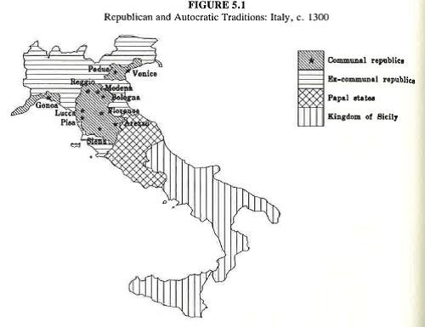
Civic Traditions in 14th century Italy

Slide 5
Italy’s medieval communal republics
Communes formed from associations of associations in Northern and Central Italy for common defence and economic cooperation.
Very high levels of civic participation, led by elites but eventually also artisans, shopkeepers.
Rise of self-governing guilds that sought wider power for the popolo
Rapid growth in commerce and trade, introduction of laws, contracts and the idea of credit.

Slide 6
Legacies and influences
Roman civic republican ideals and literature (Cicero, Livy)
Republican city-states in Italy – only Florence and Venice remain in the late 15th century. Emerging patriotism.
(Waning?) dominance of Christian ideas (including Neo-Platonism of Augustine), institutions, and political/military power.
Renaissance: Emerging Humanist traditions revived in part from Rome via Constantinople. Flowering of art and literature. History as upward progression rather than cycles of rise and decline. Optimism.

Slide 7
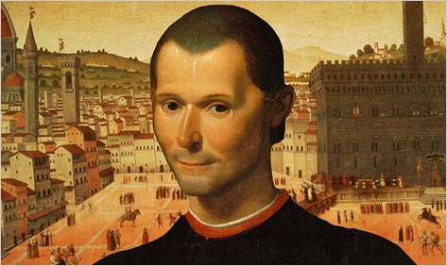

Slide 8
Niccolo Machiavelli 1469 - 1527
Time of rapid and radical political change – 150 year decline of the city-state, increasingly taken over by ‘signori’
1498 – becomes Second Chancellor, then Secretary
to the Ten of War
Emissary to papal & imperial courts
Close contact with Cesare Borgia and Pandolfo Petrucci ‘I conduct my government day by day and hour by hour…because the times are more powerful than our brains’
1503-6 Florentine militia
1512: Florence surrenders to French troops - return of the Medici
Machiavelli sentenced to internal exile
1513: tried on anti-Medicean conspiracy and tortured
Released, retreats to farm and writing

Slide 9
The Prince: A study in power and glory

Slide 10
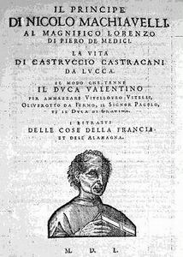

Slide 11
Reading The Prince
Riddle for modern readers: is The Prince :
1. A ‘realpolitik’ handbook on power for rulers
‘Since my aim is to write something useful for anyone who understands it, it seemed more suitable to me to search for the effectual truth of the matter rather than its imagined one….for anyone who abandons what is done for what ought to be done learns his ruin not his preservation…’
And a radical shift to a (modern) non-normative political science.

Slide 12
Or…….
2. A personal strategy for returning to a position of influence in the Medician government. Machiavelli was devastated by his banishment from politics and hoped desperately to return.
3. Clever satire of the excesses of authoritarian rule by an autocratic Prince written by a Florentine republican, and/or a satire of similar handbooks for rulers written by neo-Ciceronians stressing the importance of virtuous behaviour.
Are all these mutually exclusive?

Slide 13
The Prince : text
1513 – Machiavelli released from prison after a month and hopes for a post with the Medici lords. Writes The Prince in less than six months at Sant’ Andrea.
The Prince is not written in Latin, the language of works to be circulated among the educated and influential, but in vernacular language.
Written before/after/ or during his research for and composition of Discourses?
Machiavelli’s treatise brought no ‘attention’ from the Medici - indeed it was never presented to them.

Slide 14
Reading The Prince - structure
Ch I – XI Principalities
Ch XII – XIV Armies and war
Ch XV – XIX Qualities for which princes are praised and blamed (virtu)
Ch XX – XXIV Further advice to princes
Ch XXV Fortuna
Ch XXVI Exhortation for a free Italy

Slide 15
Subject: Principalities (‘and how to acquire and hold them’)
Principalities vs.Republics
Hereditary vs. New Principalities
Focus: new principalities ( by conquest or election)
Aim – maintain power and acquire glory

Slide 16
Glory
‘Man’s highest good is the attainment and enhancement of personal honour and glory’ Cicero, De Officiis
Machiavelli follows the roman tradition in placing glory as the underlying aim (though secured by power, which is the main focus of The Prince)
Glory is ultimately dispensed by Fortuna

Slide 17
War and armies
A. Success in war is the first and essential duty
- protect the state
conquest of territory ‘normal and natural’
Armies
- Auxiliaries (worst)
Mercenaries (dangerous)
Civil militia ‘own people’ (best)

Slide 18
Human nature
Men are fickle, liars and deceivers who
shun danger
are greedy for profit
believe in appearances and results
Why is this important?

Slide 19
What is missing?
God/church
Justice
Tomorrow:
- Virtu
- Fortuna
- Power

